Slide 1

Affordable Nutrition Planner
Empowering Zero Hunger in Kenya
An AI-powered tool for affordable, nutrient-rich meals supporting SDG 2 by reducing malnutrition in the Kenyan market
Bootcamp Final Project: September 2025

Slide 2

The Crisis We're Solving
Scale of the Problem
Economic Barriers
10M+ Kenyans face food insecurity with 26% of children under 5 suffering from malnutrition according to KNBS 2025 data.
Many families survive on less than KES 300 per day, making nutritious meal planning extremely challenging.
Knowledge Gap
Limited accessible tools help low-income households plan nutritious meals with available pantry foods.
Poor nutrition creates a devastating cycle that harms health, stunts growth, and limits future opportunities for Kenya's most vulnerable populations.

Slide 3
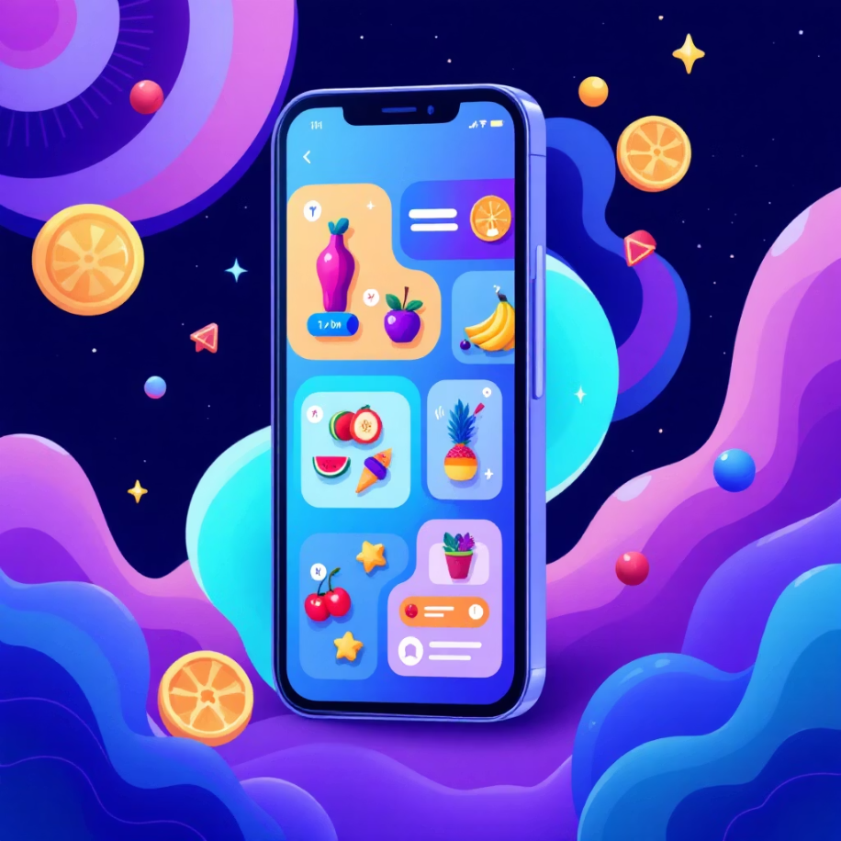
Our Solution: Smart Nutrition for Everyone
01
Input Available Resources
Users enter owned foods and daily budget constraints into our intuitive web interface.
02
AI Optimization Engine
Advanced algorithms ensure meal plans meet essential nutrients including calories, protein, vitamins and minerals.
03
Cultural Recipe Integration
System suggests authentic Kenyan recipes like ugali na sukuma wiki using optimized ingredient combinations.
Free • Mobile-Friendly • Culturally Relevant
04
Free Public Access
Mobile-friendly web app hosted publicly, ensuring accessibility for all Kenyan households regardless of income.

Slide 4





Powerful Features That Make a Difference
Custom Food Input
Dynamic Price Updates
Personal Preferences
Add owned foods with specific quantities like "Maize Flour, 1 kg" to maximize existing resources and minimize waste.
Real-time price scraping from Naivas.online ensures accurate cost calculations for budget-conscious meal planning.
Accommodate vegetarian diets and allergy exclusions including common allergens like peanuts for safe meal planning.
Nutrient Visualization
Cultural Recipes
Interactive charts display nutrient contribution breakdowns, helping users understand their meal's nutritional value.
Features authentic Kenyan dishes including ugali na sukuma wiki with step-by-step preparation instructions.

Slide 5

Built with Cutting-Edge Technology
Python Core
PuLP Optimization
Scalable backend logic handling complex nutritional calculations and user data processing efficiently.
Advanced linear programming AI engine that optimizes meal plans for maximum nutrition within budget constraints.
Streamlit UI
Data Integration
User-friendly web interface that makes complex nutrition planning accessible to non-technical users across Kenya.
Pandas processing combines Naivas pricing APIs with USDA nutritional databases for comprehensive meal planning.
Deployed free on Streamlit Community Cloud for universal access

Slide 6


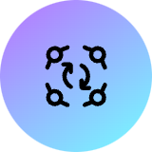







Advancing SDG 2: Zero Hunger
Extreme Affordability
Food Waste Reduction
Universal Accessibility
Creates nutritious meal plans for budgets as low as KES 300 per day, reaching Kenya's most vulnerable populations.
Maximizes use of owned pantry items, promoting sustainable consumption and reducing household food waste significantly.
Free public web app enables community centers, schools, and health clinics to provide nutrition planning services.
Complete Nutrition
Cultural Integration
Ensures daily requirements including 2500 kcal and 50g protein are met through scientifically-optimized meal combinations.
Features beloved Kenyan staples and traditional recipes, ensuring nutrition solutions respect local food preferences and customs.

Slide 7
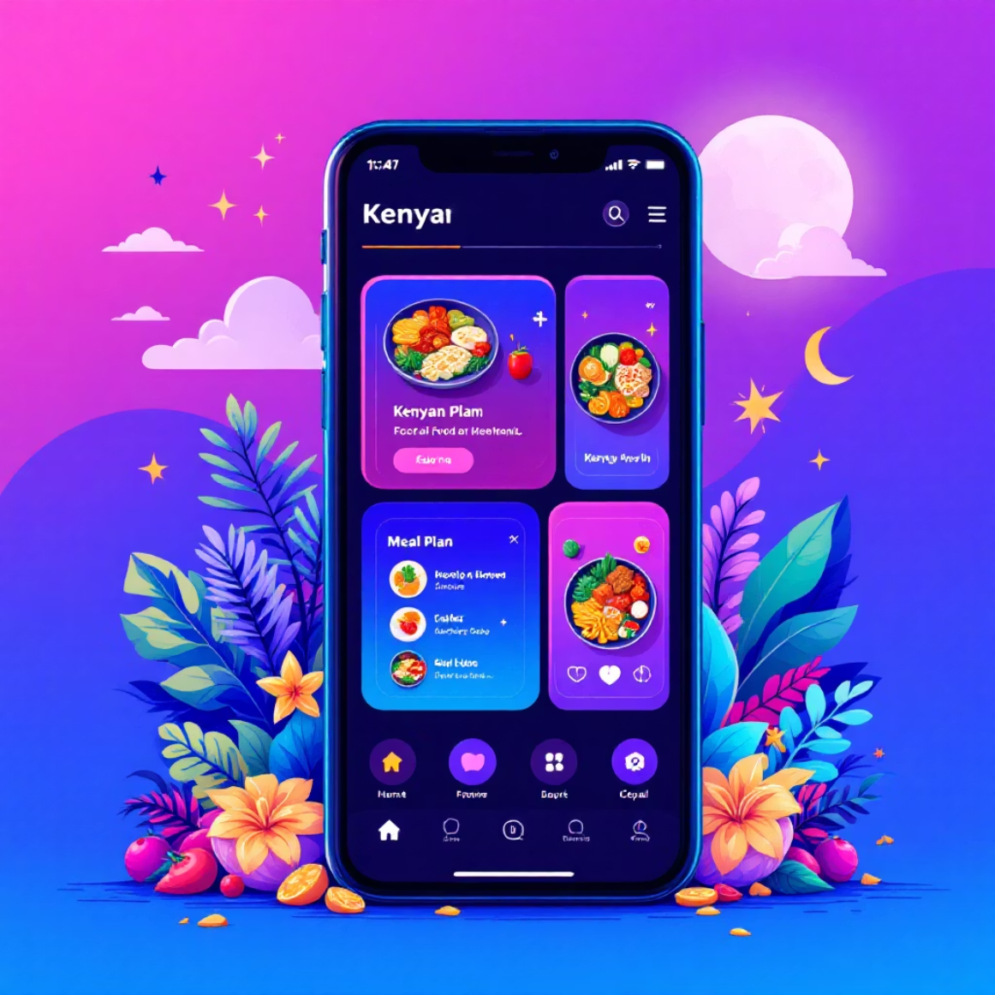
See It in Action
Live Demo Available Now
https://nutrition-app.streamlit.app
01
Sample Input
Budget: KES 300, owned Maize Flour (1 kg), exclude peanuts for allergy safety
02
Instant Output
Optimized diet plan with nutrient breakdown chart and ugali na sukuma wiki recipe instructions
03
Try Customization
Add custom foods like apples or modify preferences to see real-time plan adjustments
Test the app with your own food inventory and budget constraints!

Slide 8

My Bootcamp Journey: Challenges & Growth
Challenges Overcome
Skills Gained
Mastered PuLP linear programming library for complex nutritional optimization algorithms
Advanced Python programming with data science libraries
API integration and web scraping techniques
Implemented robust web scraping with fallback systems for reliable price data collection
Full-stack web development and cloud deployment
Debugged Streamlit deployment issues including critical requirements.txt dependency management
Git version control and collaborative development workflows
Impact Achievement: Built a real-world tool addressing malnutrition in Kenya within just a few intensive weeks of learning!

Slide 9
Future Enhancements: Scaling the Vision
Recipe Expansion
1
Add popular Kenyan dishes including githeri, ndengu curry, and seasonal vegetable combinations for greater variety.
2
Mobile UX Optimization
Enhance interface specifically for rural smartphone users with improved offline capabilities and simplified navigation.
Sustainability Metrics
3
Integrate carbon footprint tracking to promote environmentally conscious food choices alongside nutritional optimization.
4
Local Market Integration
Partner with additional Kenyan markets and vendors for more accurate regional pricing and availability data.
Community Outreach
5
Deploy QR code access systems in schools, health clinics, and community centers for broader population reach.

Slide 10

Join the Fight Against Hunger
For Bootcamp Evaluation
For Kenyan Communities
This project showcases both my technical coding abilities and deep passion for creating meaningful social impact through technology.
Share this free tool with households, community centers, and health organizations across Kenya to multiply our impact.
Get Involved
Try the app, provide feedback, and suggest new features that could better serve Kenya's nutritional needs.
Next Steps
Try the Live Demo
Expanding to address additional health and sustainability SDGs through technology-driven solutions for developing communities.
nutrition-app.streamlit.app
Together, we can end hunger in Kenya
Contact: [Your Email or GitHub]

